Slide 1

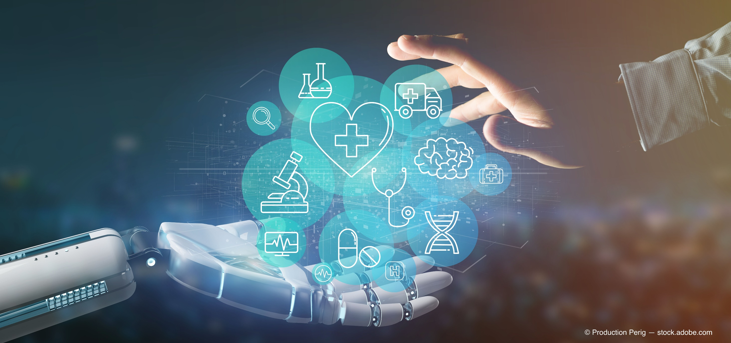
Project Review (10th April 2021)
Artificial Intelligence in
Medicine
Sreshta R Putchala
160117733140

Slide 2

panace.ai
Democratizing Precision Medicine
Democratize affordable and ubiquitous medical interventions.
Make the most accurate diagnosis and evolve effective treatment of medical conditions, from detection & diagnosis to prescriptions & treatment.
Provide precision medicine and provide highly personalized medical treatment (including diet, exercise besides medicines) for patients.
Utilize evidence-based medical decision-making driven by state-of-the-art Artificial Intelligence.
Notes:
This solution cannot be adversarial to the doctors or healthcare professionals but complementary. It can be aid for a second opinion and enhanced Hypothesis the humans may have to consider. The advantages of our solution are:
Reduced Time to eventual diagnosis (fast elimination of contradicting factors)
Reduced Diagnosis errors
Explainable AI that precisely lays out the path of diagnosis pathway.
Exhaustive search that considers even rare diseases.
Reduced cost of Diagnosis
knowledge available to a general physician instead of a specialist, who's bandwidth is limited. This saves valuable specialist time!

Slide 3
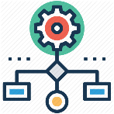


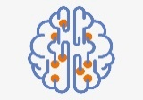
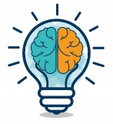
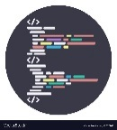


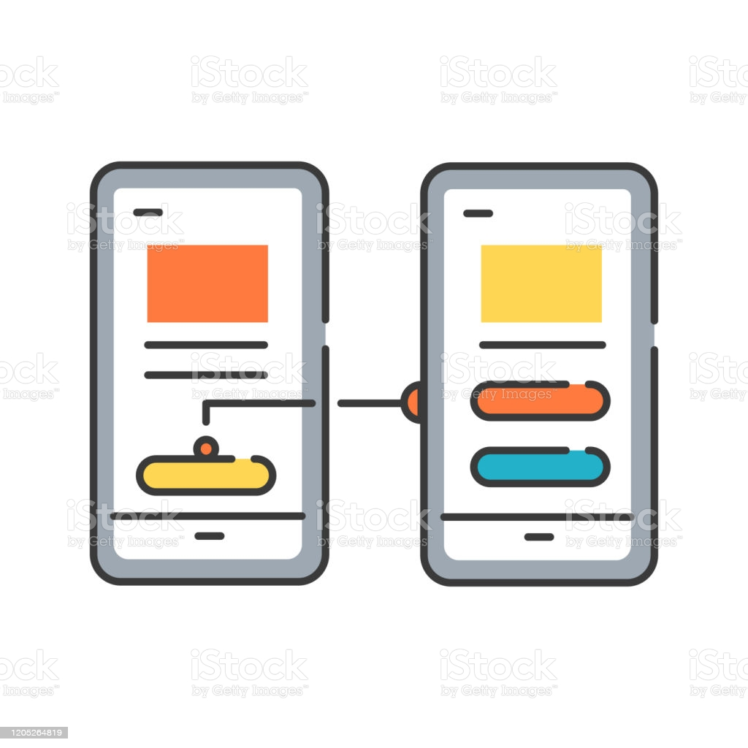
Project Activities
Design and develop the workflow "Healthcare process" from Diagnosis to Prescription
Identify and Scope the targeted Diseases for PoCs (based on the data availability)
Identify the data sources, cleansing methods
Identify appropriate ML/AI algorithms and create ensemble solutions for each of the modules
Create Knowledge representations (either procure or develop data appropriately)
Develop the PoCs for the core-algorithms and functionality
Identify Github for similar projects
Develop the Prototypes for envisioning look and feel
Create Unique problem solving methods and file for Patents (IP creation)

Slide 4
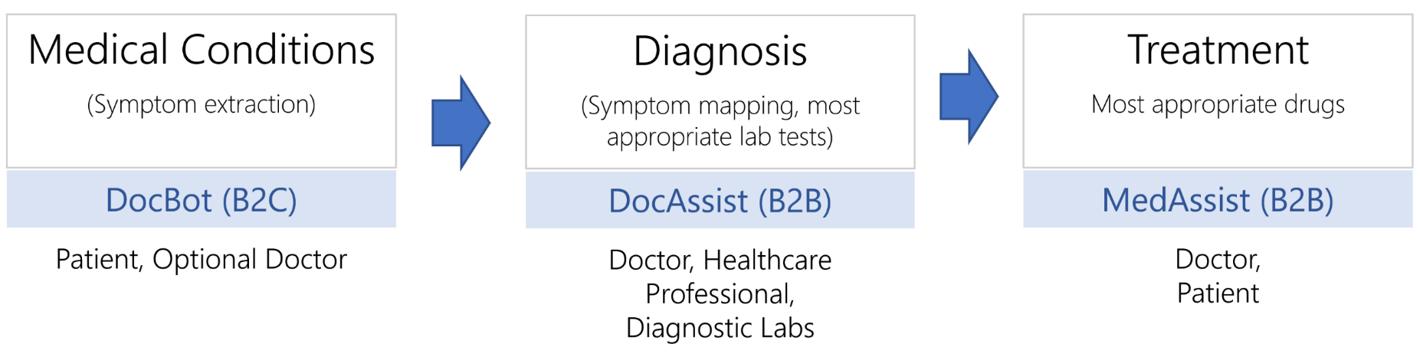
panace.ai components
Notes:
A medical condition (a disease or disorder) denotes a state of health that generally requires treatment for the patient. Medical conditions can be self-diagnosed based on symptoms, but they are more often diagnosed by a doctor or other professional.
Medical professionals generally diagnose a disease, condition, or disorder through one or more of the following methods:
Physical examination
Lab tests (such as a blood, urine, stools tests)
A psychological evaluation
Some common diagnostic tests are mammography (an X-ray to determine breast cancer), echocardiography (ultrasound waves to check the heart), colonoscopy ( to examine the colon), and magnetic resonance imaging (MRI; medical imaging that produces images of internal organs) and many others. Our focus in the solution will leave-out CV related test results to other specialized startups in this area (partnership potential)
Once a disease has been diagnosed, a medical professional or team of professionals in the healthcare system will determine how to treat it. In some cases, the treatment will cure the condition and symptoms. If the disease cannot be cured, the treatment plan will determine how to manage the disease in order to minimize its effects on the patient and the symptoms present. Treatment may include prescription drugs (medicine), surgery, or other options.

Slide 5
Function Map
Input Case
Symptoms Extraction
Create Clinical Graph
Differential Diagnosis
Diagnostic tests
Data lake, B2B EDIs, OCR
EMR Extract
Dialog and User Interface
Match graph
Patient/Medical History
Bayesian Inference and Knowledge Graphs
Final Diagnosis
Initial Questions
Knowledge Graph
GoogleMind API
Patient Profile
Genomic Data
Symptom Capture
Driven by Word2Vec and Knowledge Graph & Symptomate API
Geo-regions
Personalized
Treatment
Diet and Nutrition
Interviews and Chat
Driven by Knowledge Graph, Bayesian Belief Network
Drug Data
Clinical Report and initial assessment
Text Summarization,
Topic Mining (LDA)

Slide 6



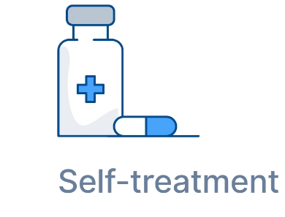
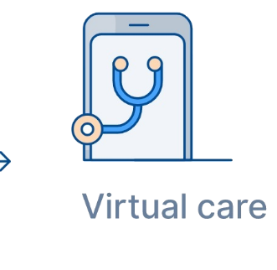

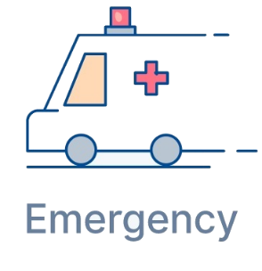
Benefits
Hospitals
Physicians
Increased specialist bandwidth. Knowledge available to a general physician instead of a specialist.
Provide the most appropriate care for patients - self-treatment, teleconsultation, consult a doctor, or seek immediate medical treatment.
Patients
Reduced cost of Diagnosis
Minimize over and under-triage
Prevent unnecessary visits to Clinics, Diagnostic centers and hospitals.
Most appropriate treatment
Access to medical interventions and treatment through teleconsultations
Connect to an accessible/appropriate medical provider
Immediate medical intervention, consultation or access to trusted or appropriate medical information
Reduced Time to eventual diagnosis
Quick elimination of contradicting factors
Provide the most appropriate diagnostic tests to validate the initial diagnostics
Considers Patient history, risks and context while producing differential diagnosis
Explainable AI that precisely lays out the path of diagnosis pathway.
Reduced Diagnosis errors
Exhaustive search that considers even rare diseases.
Clinical decision support. Acts like a second opinion for the physicians
Notes:
This solution cannot be adversarial to the doctors or healthcare professionals but complementary. It can be aid for a second opinion and enhanced Hypothesis the humans may have to consider. The advantages of our solution are:
Reduced Time to eventual diagnosis (fast elimination of contradicting factors)
Reduced Diagnosis errors
Explainable AI that precisely lays out the path of diagnosis pathway.
Exhaustive search that considers even rare diseases.
Reduced cost of Diagnosis
knowledge available to a general physician instead of a specialist, who's bandwidth is limited. This saves valuable specialist time!

Slide 7
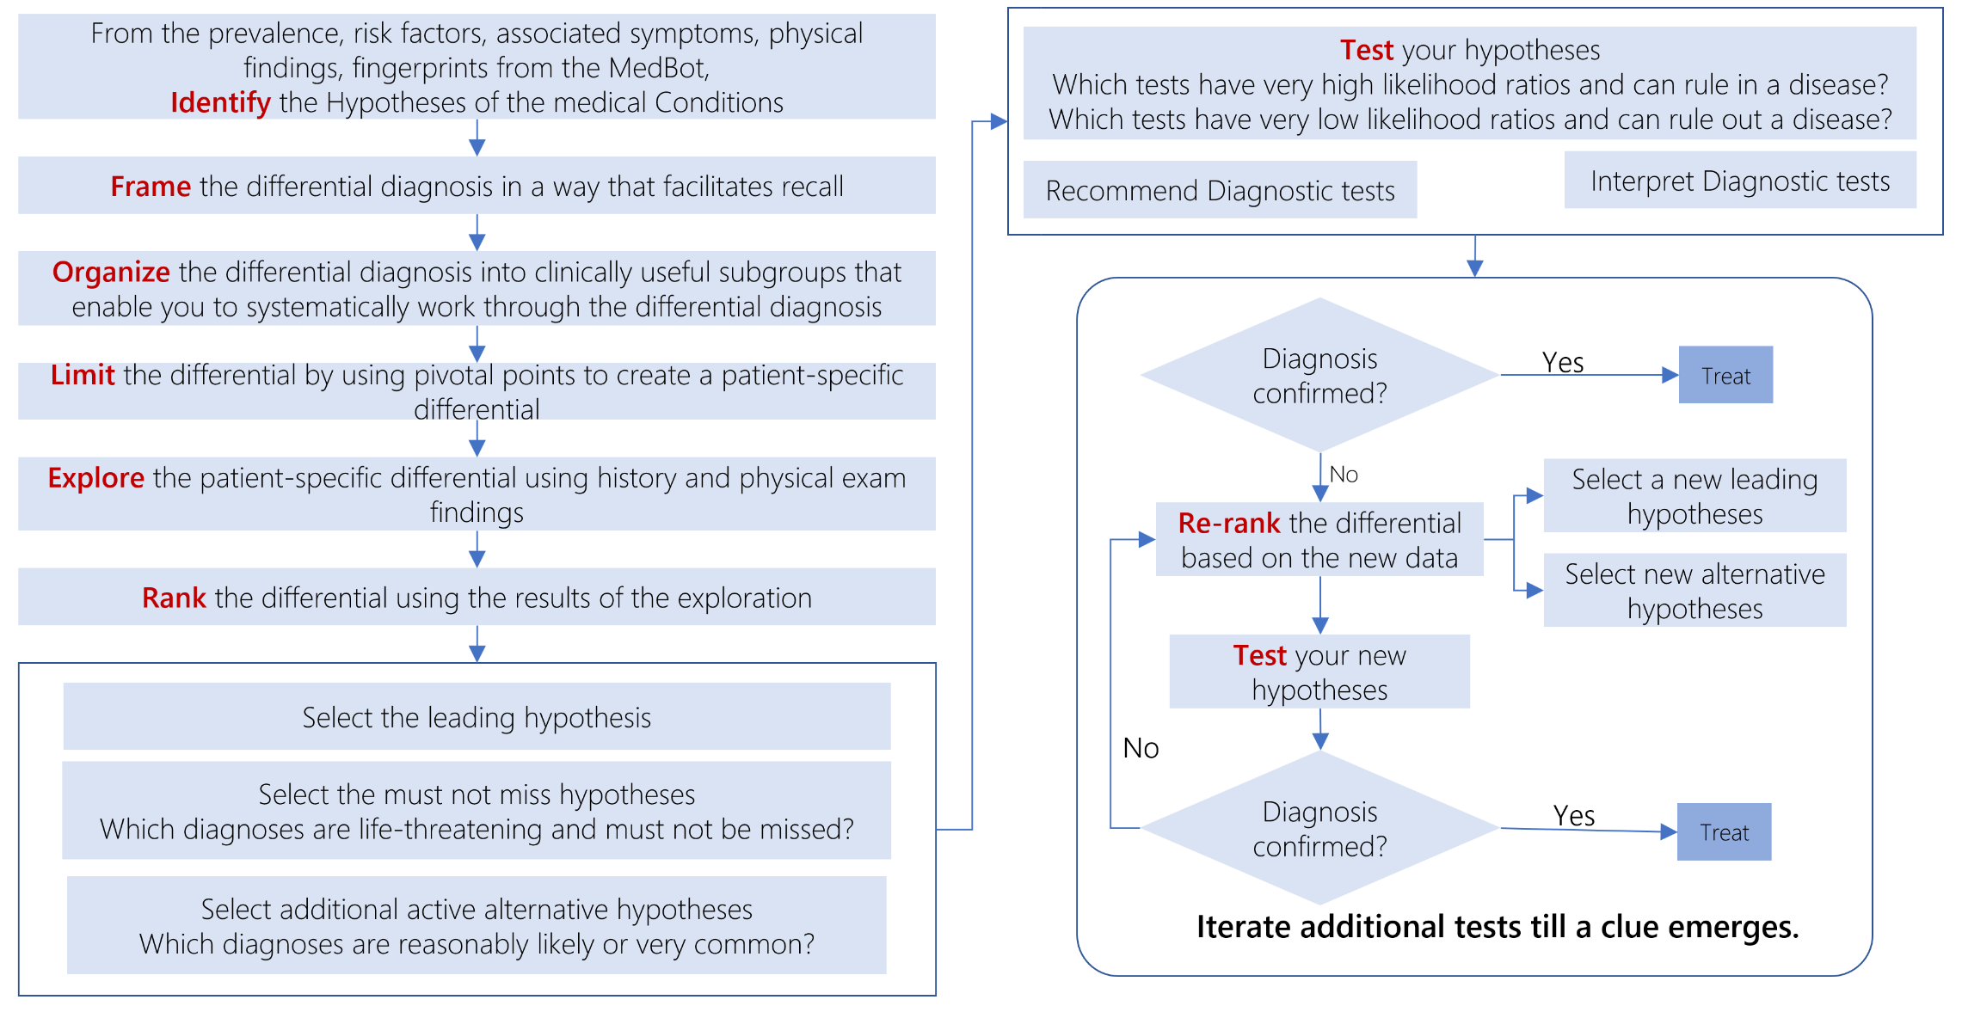
Diagnosis to Treatment

Slide 8
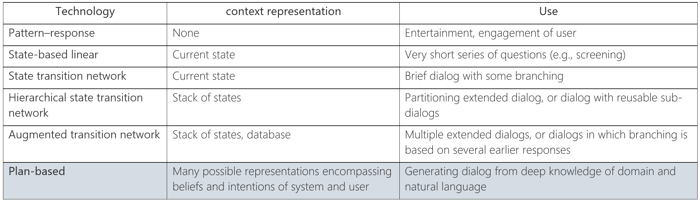
Bot Sophistication

Slide 9
Ensemble of bots Architecture
User Input
Classifier
Retrieval bot
(NLP)
Decision Tree Based bot
Bayesian Belief Network
API called
Expert System
Output (Response)

Slide 10
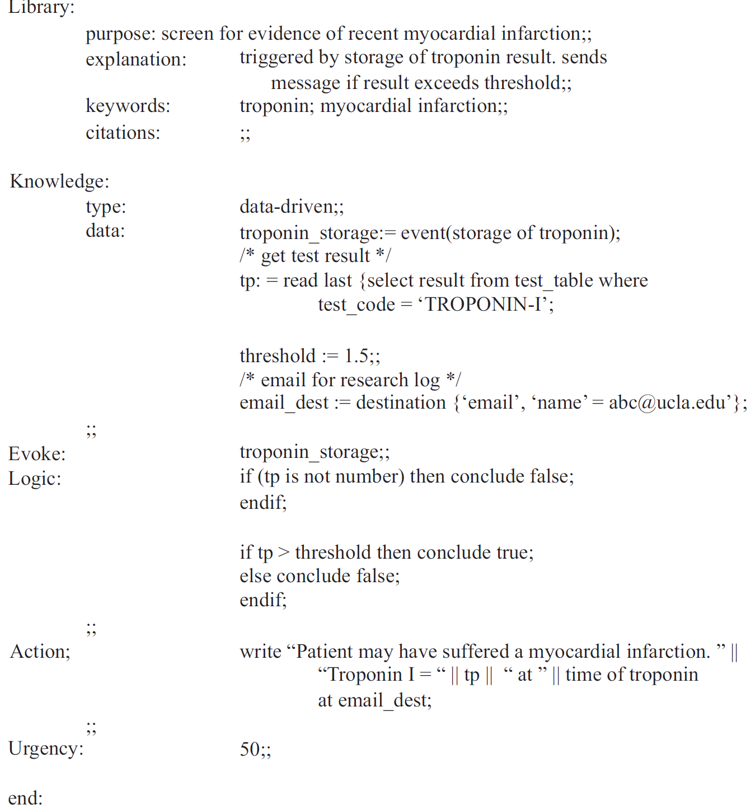
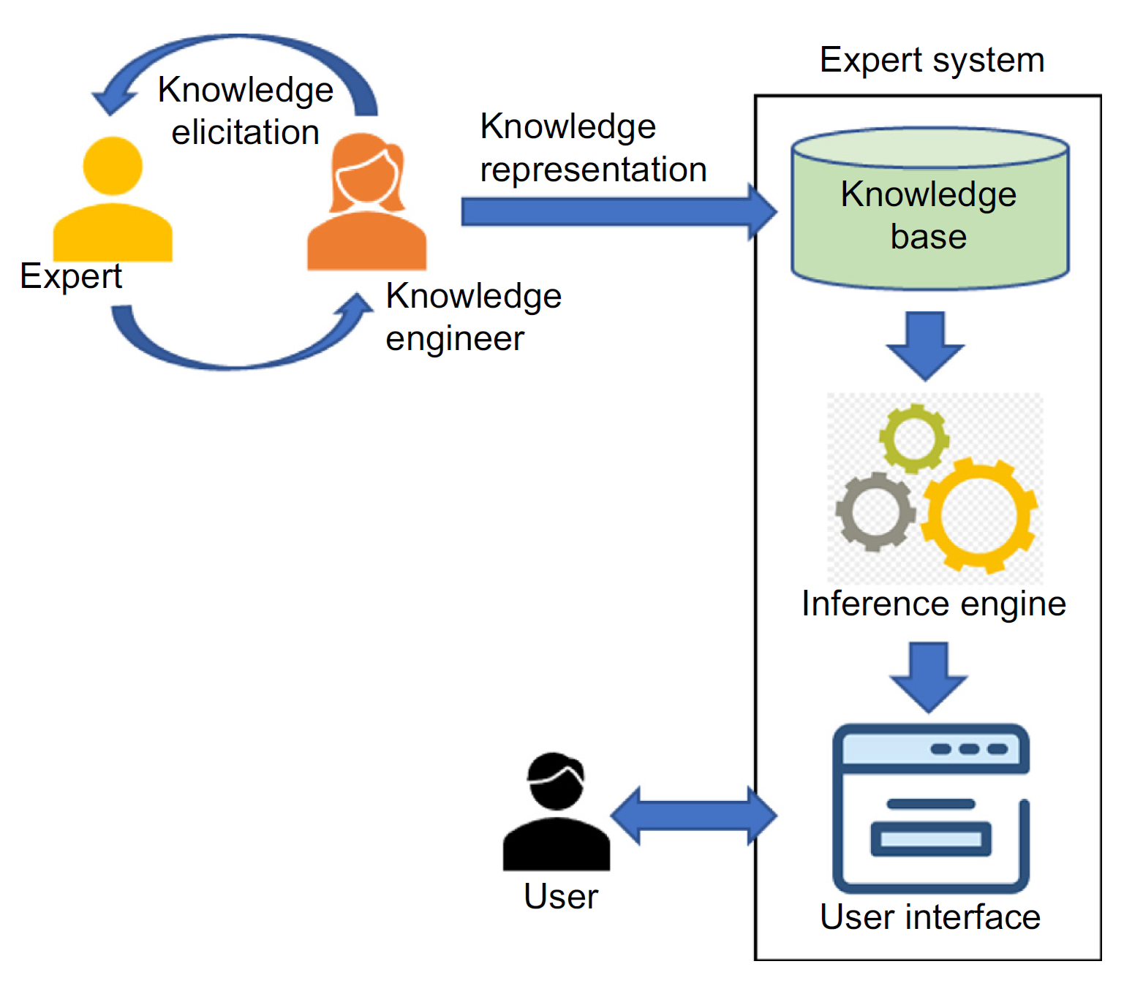
Expert Systems

Slide 11
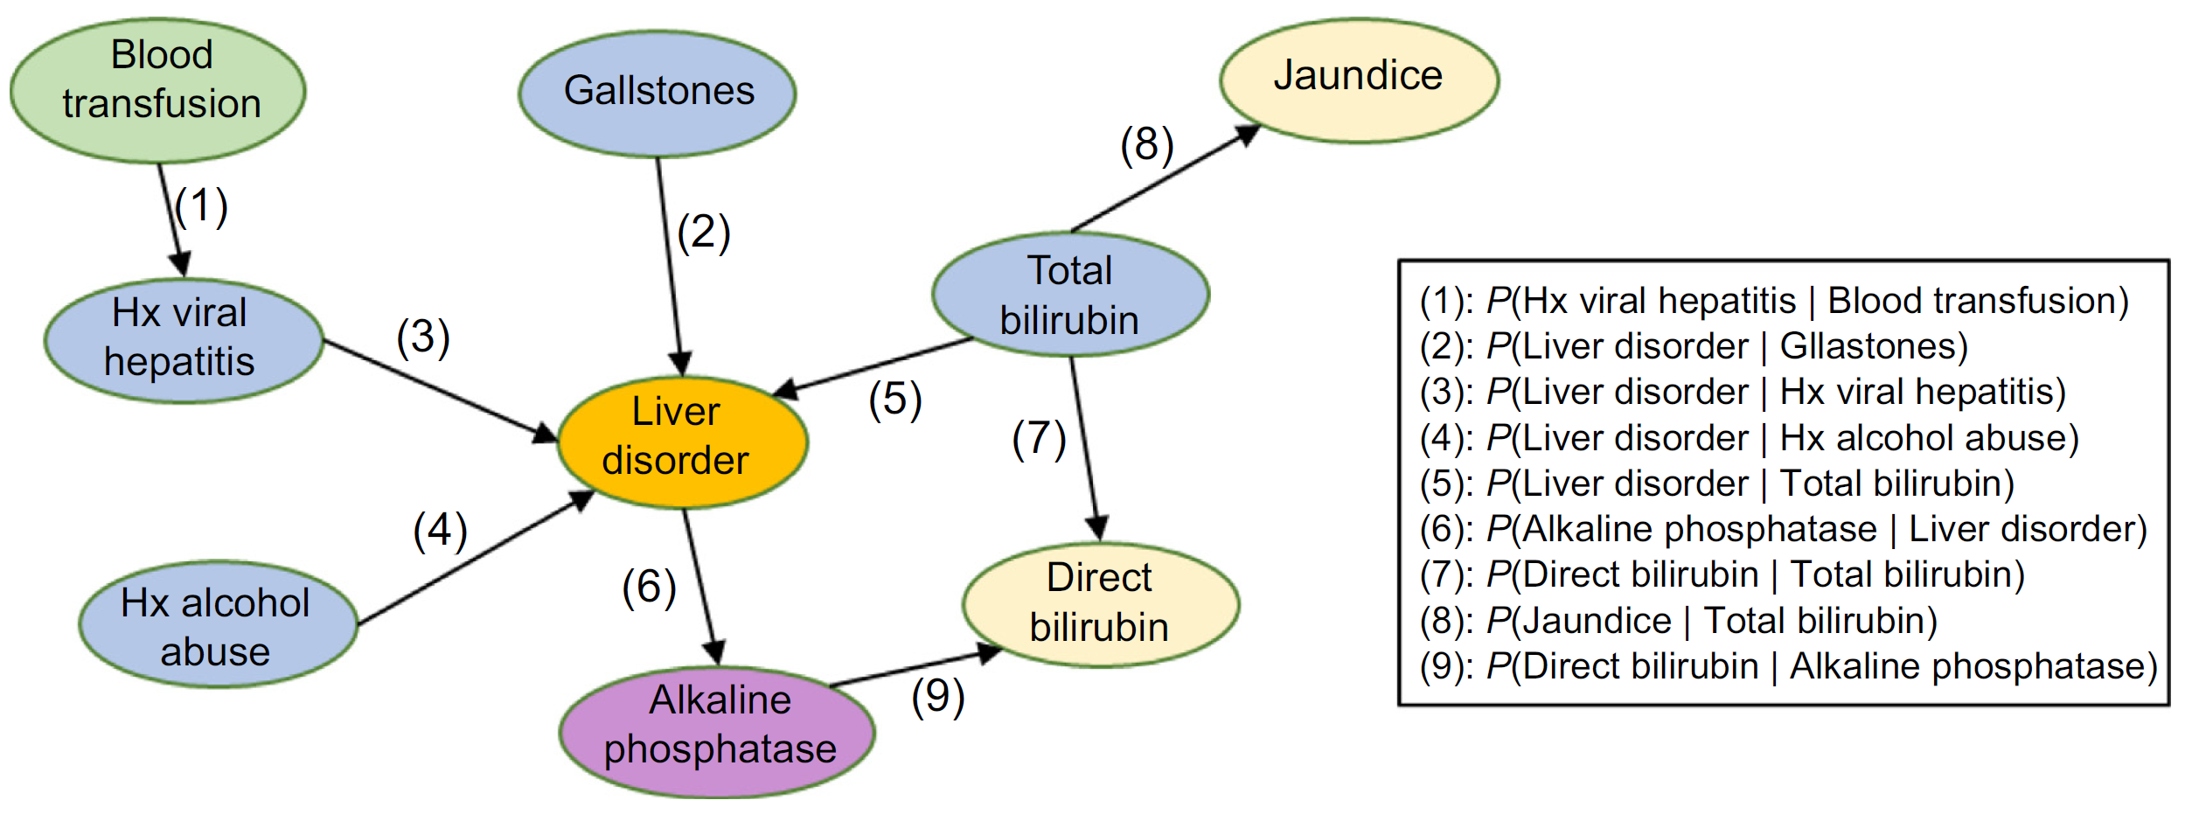
Bayesian Belief Network
Knowledge Graphs
Derived from the Clinical Diagnosis Book
Probability Weights
Derived from Medical records
Simplified Bayesian network for diagnosis of liver disorder. Source: Adapted from Onisko A, Druzdzel MJ, Wasyluk H. A Bayesian network model for diagnosis of liver disorders. In: Proceedings of the eleventh conference on biocybernetics and biomedical engineering. CiteseerX; 1999.

Slide 12
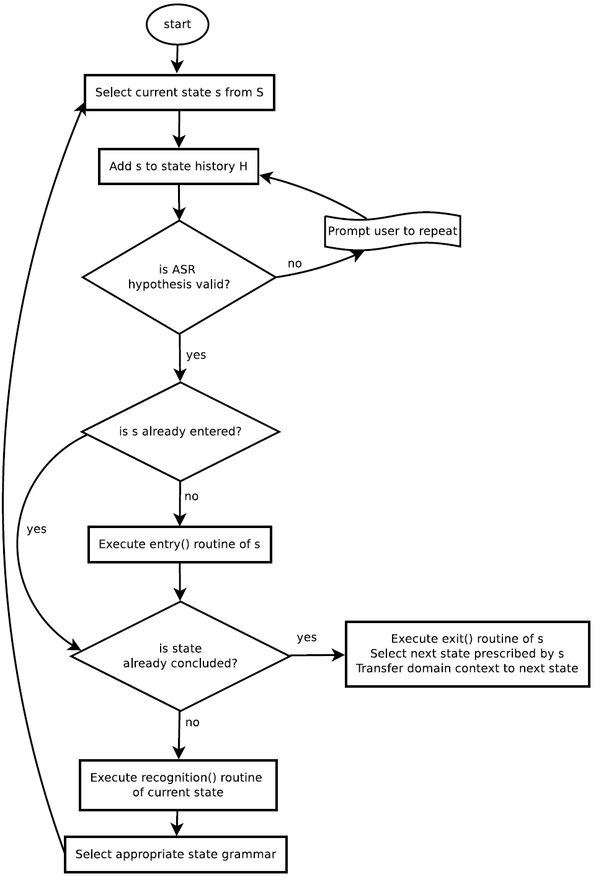
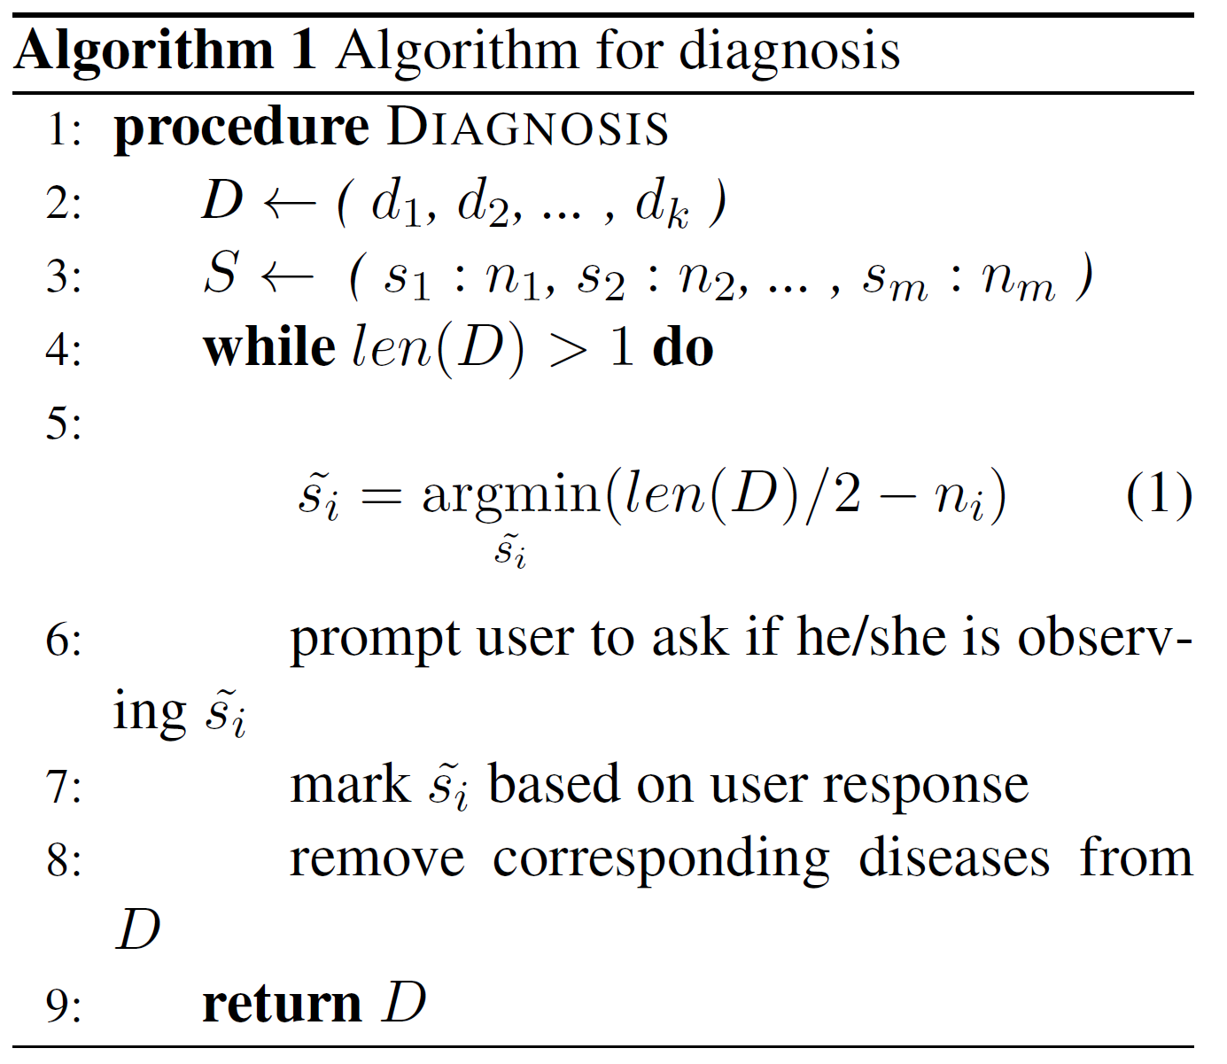
Panace.ai Bot Framework
greet state
ask symptoms state
diagnosis state
disease details state
symptoms details state
disease enquiry state
first aid state

Slide 13









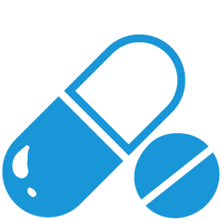
Medicine: Older Paradigms
Adverse Event
No Benefit
Therapy (mainly Rx)
Benefit
Patient groups benefit from more a targeted treatment
Traditional Medicine
Stratified Medicine
Notes:
Modern drug design is the inventive process of finding new medications based on the knowledge of a biological target. It involves the design of molecules that are complementary in shape and charge to the
biomolecular target with which they interact and therefore will bind to it.

Slide 14


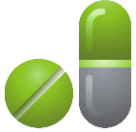

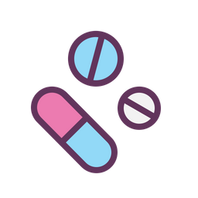

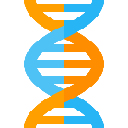






Personalized Medicine
Therapy (Rx + Dx = CDx)
Each patient benefits from individualized treatment
Companion Diagnostic (CDx) Biomarker
Notes:
Modern drug design is the inventive process of finding new medications based on the knowledge of a biological target. It involves the design of molecules that are complementary in shape and charge to the
biomolecular target with which they interact and therefore will bind to it.

Slide 15

Biomarkers and Precision Medicine
Filter Documents with Keywords : Cancer, Biomarker, Gene, Mutation, Drug etc.,
Electronic access to medical research
Extract Text from pdf files
https://pubmed.ncbi.nlm.nih.gov/
Document Classification
https://www.nlm.nih.gov/bsd/indexing/training/PUB_010.html
Indexing process : https://www.nlm.nih.gov/bsd/indexing/training/TIP_010.html
Pathology Reports
Reviews
Clinical Trials
Research papers
Articles/Editorials
Drugs Genes
Drugs Disease
Disease Genes
Gene Mutations
Patient – Genome Mapped
Gene Mutations
Drug and Dosage Instructions
Document Similarity
Document Relevance and Scoring
Predisposition
Prognosis
Diagnostic
Biomarker various DBs
BRAT
Brat Rapid Annotation Tool (developed by Stenetorp et al.)
BIET
Biomarker information extraction tool
EDGAR
Extraction of Drugs, Genes And Relations from the Biomedical Literature
MarkerArk
automated data extraction from published scientific publications and populate Markerville biomarker DB
panace.ai ensemble
Extraction of Drugs, Genes and Relations from the Biomedical Literature using Deep Learning
panace.ai curation
Consolidating, standardizing (JSON and MongoDB) as a Opensource project.
Demos:
Structure of pubmed
Some Biomarker DBs
NLP Demos (Bi-gram visualizations, Entity Extraction – NER)
Gene Mutations Data
Precision Medicine Maps and Instructions

Slide 16
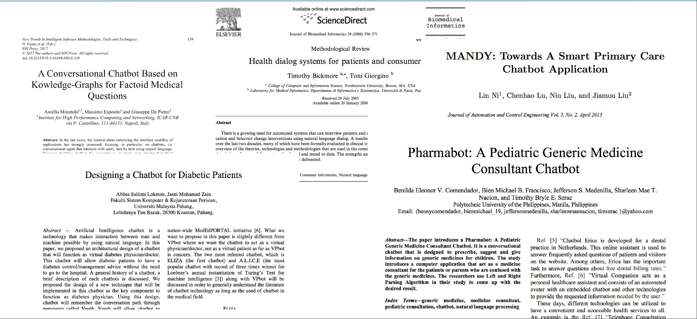
Literature

Slide 17

Thank you!
Notes:
Modern drug design is the inventive process of finding new medications based on the knowledge of a biological target. It involves the design of molecules that are complementary in shape and charge to the
biomolecular target with which they interact and therefore will bind to it.

